Slide 1



LARANA, INC.
SNOWMAN
ASSIGNMENT
ONG, CHARLES

Slide 2

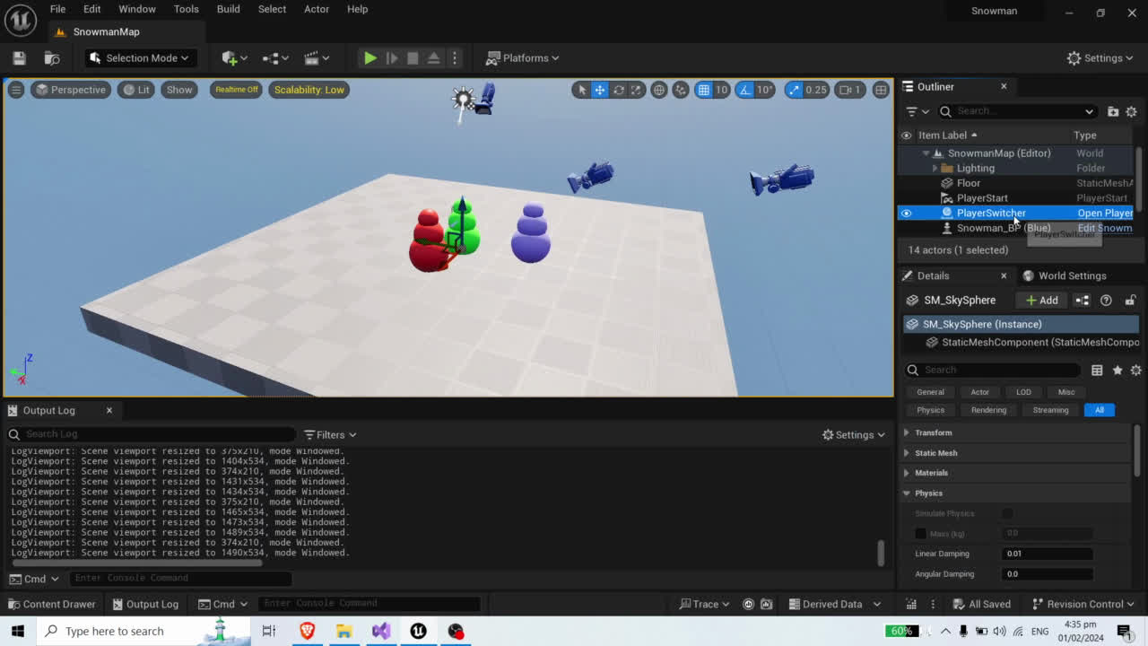
DEMO
ECS (Green), Inheritance (Red), Blueprint (Blue)

Slide 3
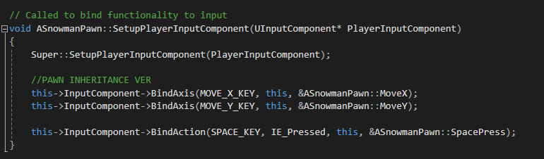


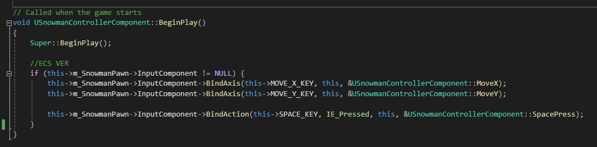

ECS VS INHERITANCE
Same process but need to get parent pawn’s components.
Also different setup functions.
KEY BINDING

Slide 4
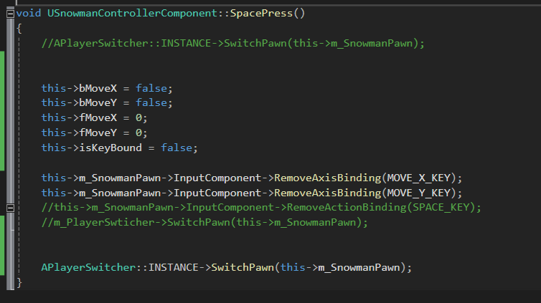
CALLING OUR SWITCHER SINGLETON
Call the Manager to switchPawn() when our SpaceKey is pressed.
CALLING SINGLETONS

Slide 5
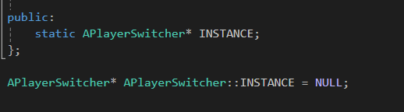
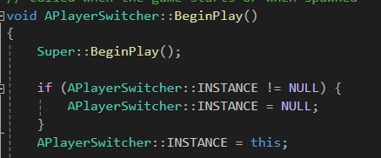
SINGLETONS & GARBAGE COLLECTION
Unreal does NOT auto delete static Instances.
This results in crashes since it accesses the previous run’s instance with Null Pointers.
CLEANING SINGLETONS

Slide 6
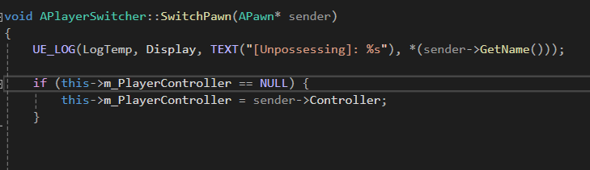
POSSESSING PAWNS
Unreal creates only ONE controller at runtime.
Capture and store it for use later.
STORING CONTROLLER

Slide 7
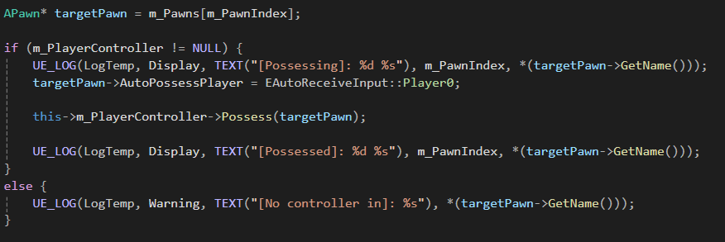
POSSESSING PAWNS
To switch possess a Pawn, use AController::Possess().
POSSESSING PAWNS

Slide 8
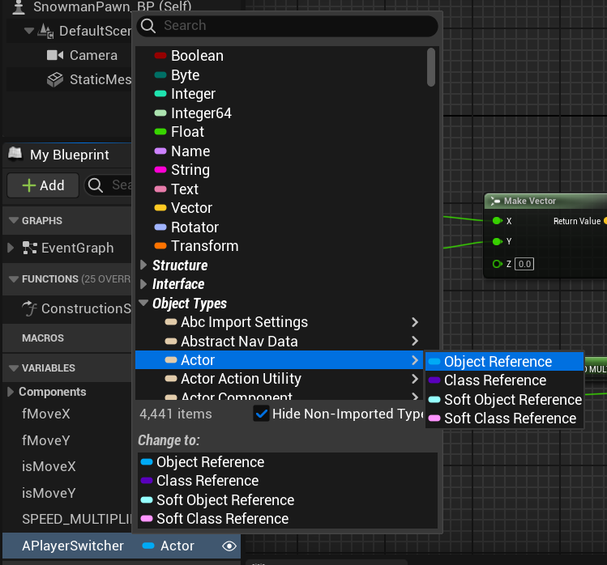
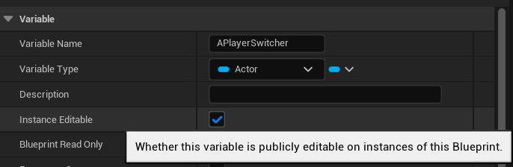
OBJECT REFERENCES IN BP
Create an
Actor>Object Refernce variable.
Make editable to expose it in the Scene Details window.
CREATION

Slide 9
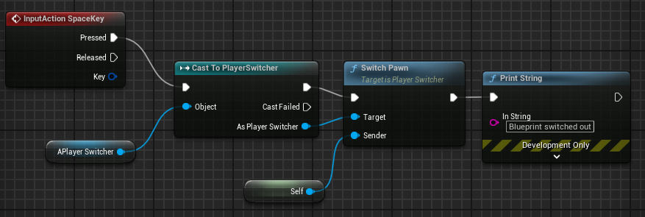
OBJECT REFERENCES IN BP
Cast your BaseClass variable into its proper class to be to see its BluePrintCallabale functions and vars.
CASTING

Slide 10
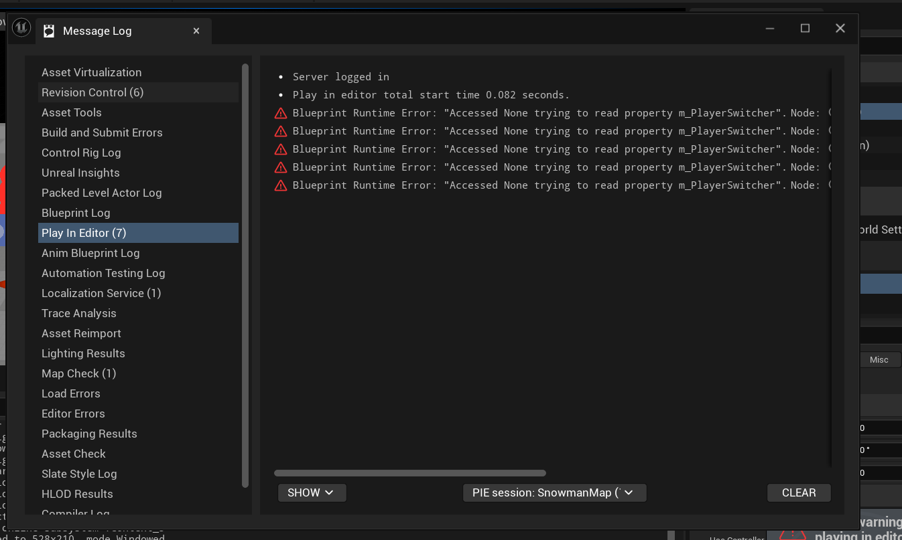
BLUEPRINT SUPERIORITY
Null Pointers
Blueprints report Null references without crashing.
This allows faster and better debugging than what C++ coding can provide.

Slide 11
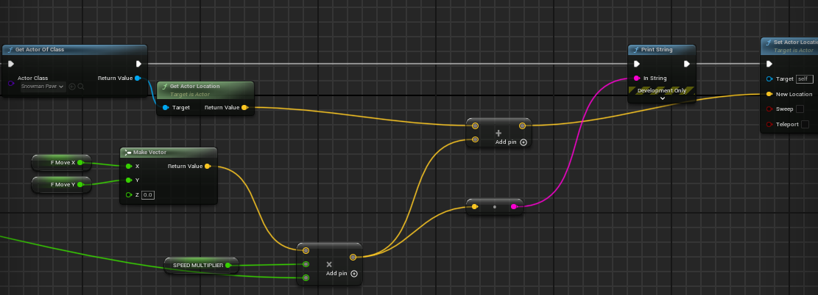
BLUEPRINT SUPERIORITY
Mismatch Prevention
Blueprints greatly assist in conversion and typecasting.
Mismatched values are rejected in parameter fields.

Slide 12
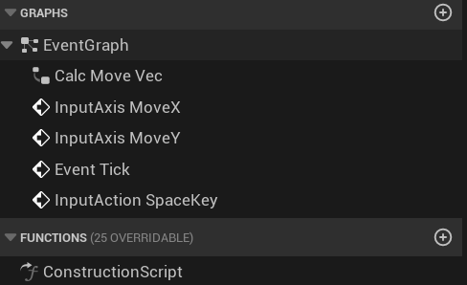
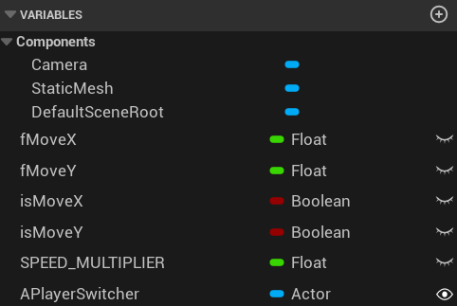
BLUEPRINT SUPERIORITY
Readability
Details and properties can be easily hidden and navigated via dropdown menus.

Slide 13
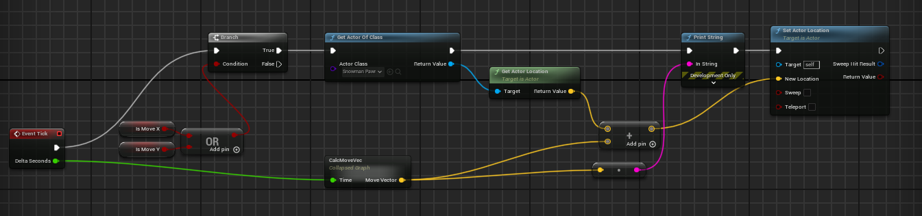
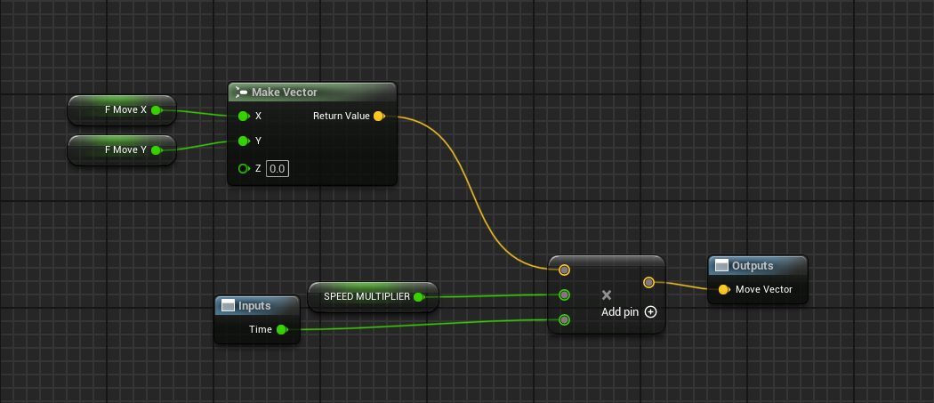
BLUEPRINT SUPERIORITY
Readability
Blueprints show a consistent flow.
It allows better organization and monitoring of processes.
Injecting & collapsing functions are also done more quickly.

Slide 14
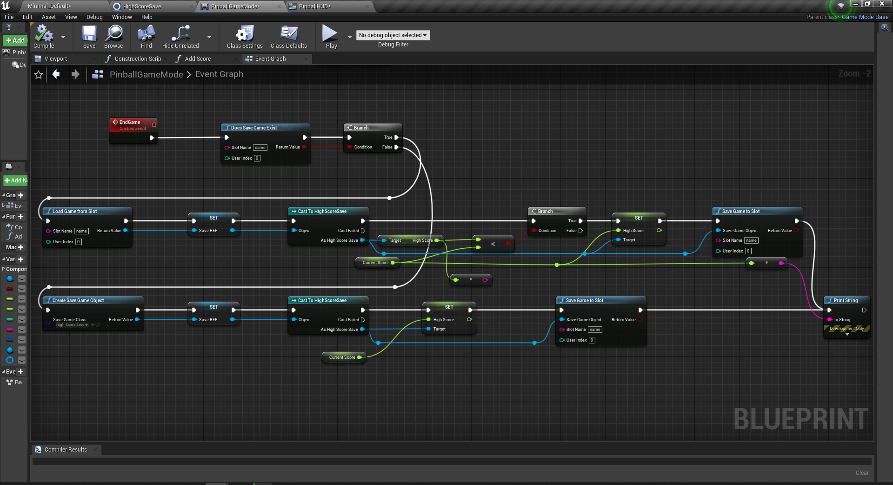
MY PREFERRED
METHOD
Safer, Modifiable, and Observable

Slide 15

PLEASE LET US USE VISUAL SCRIPTING
CHARLES

Slide 16
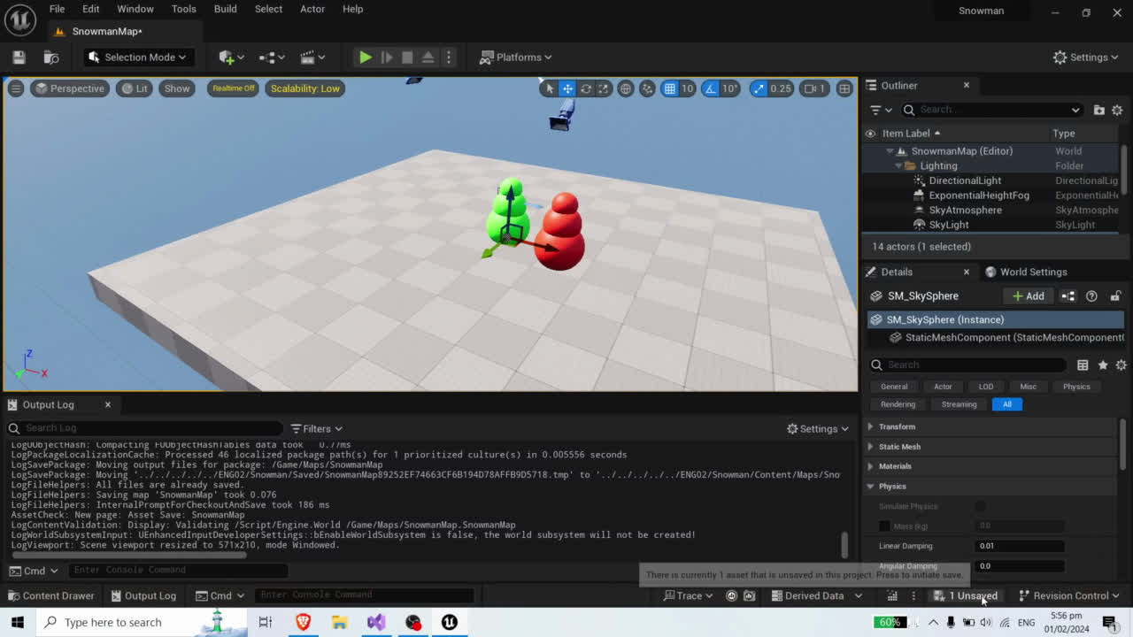
SAVE, BUILD, COMPILE, REPEAT
ALSO CLOSE THE EDITOR PROPERLY

